Slide 1

Your past. Your present. Your future.
Notes:
I would like you to try and remember your happiest memory. Now, think about yourselves 40 years from now. You may no longer remember that moment. Wouldn’t you like to capture those moments and relive them in the future? That’s what Capsulefy is about.

Slide 2
OVERVIEW
Idea
Team
MVP
Technologies
Viability study
Competitors
Pilot users
Planification
Costs
Profit estimations

Slide 3
IDEA

Slide 4





IDEA: TIME CAPSULE
Write
Schedule
Wait
Publish

Slide 5


IDEA: DEADMAN SWITCH
ON

Slide 6
TEAM

Slide 7
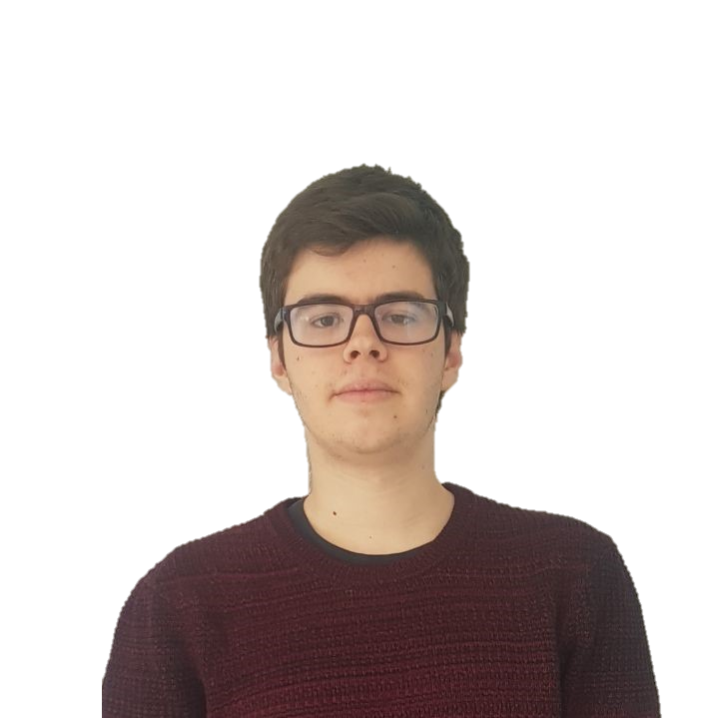



TEAM
Pablo Rebollo
Project manager, backend developer

Slide 8



TEAM
Adrián Cantón
Business manager, full-stack developer

Slide 9


TEAM
Daniel Carpio
Analist, frontend developer

Slide 10


TEAM
Juan Rodríguez
Requirements engineer, backend developer

Slide 11


TEAM
Rafael Fresno
Backend developer, API integration

Slide 12




GOALS

Slide 13
MVP

Slide 14

CLASSIFICATION
=

Slide 15
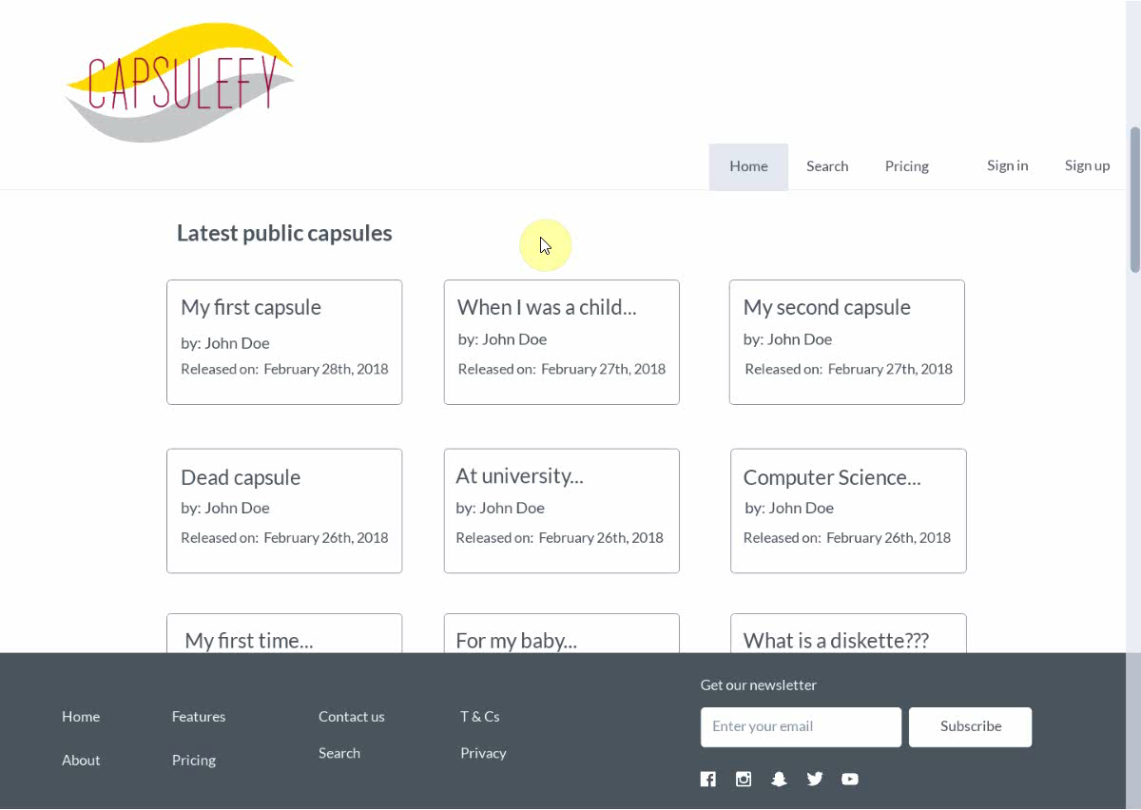
No logged user
Listing capsules

Slide 16
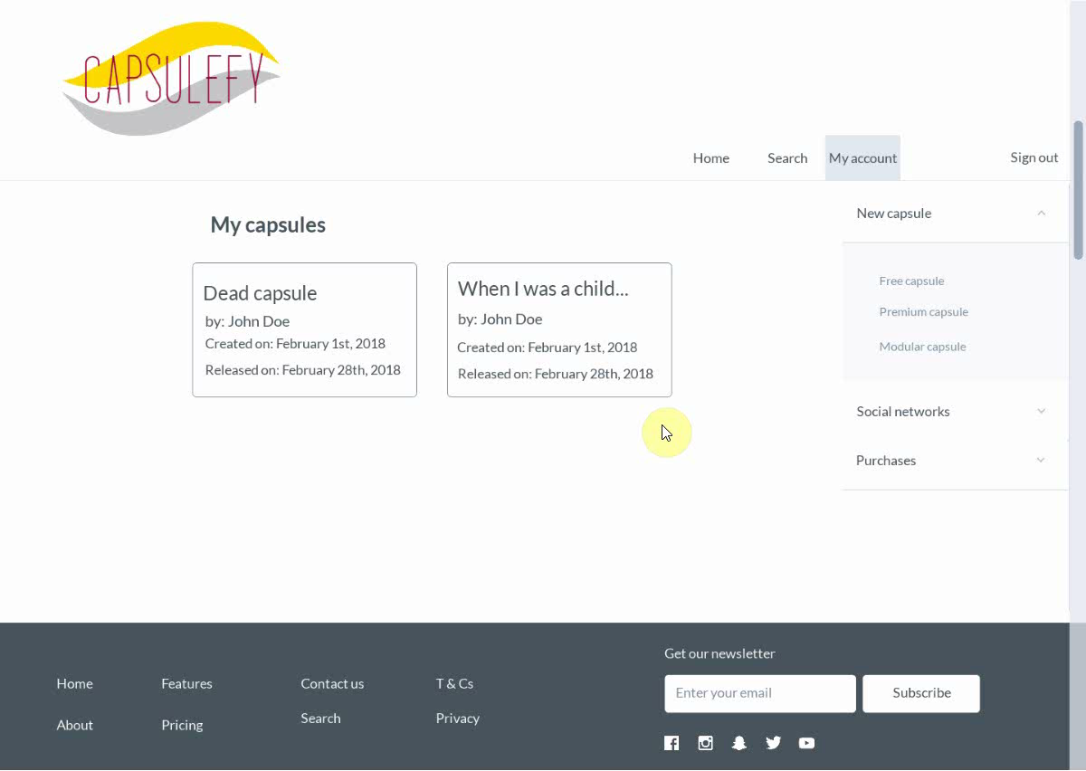
Logged-in user
Free capsules

Slide 17

Logged-in user
Premium capsules

Slide 18
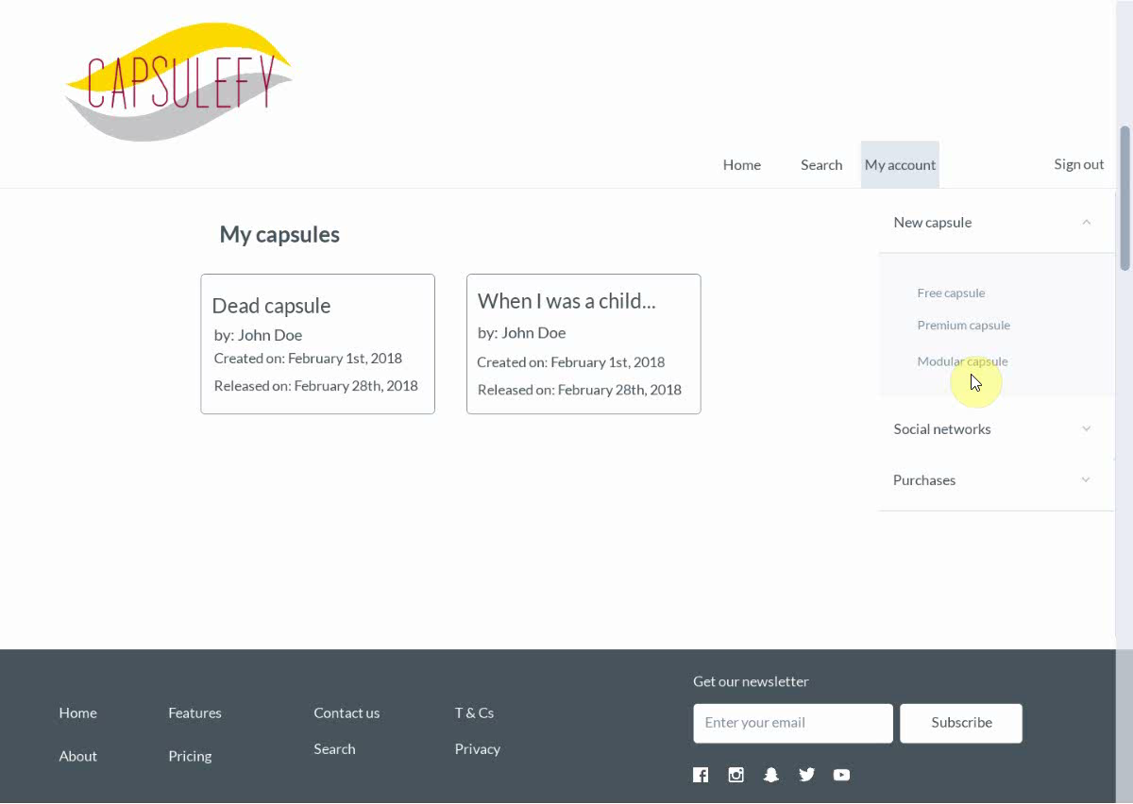
Logged-in user
Modular capsules

Slide 19
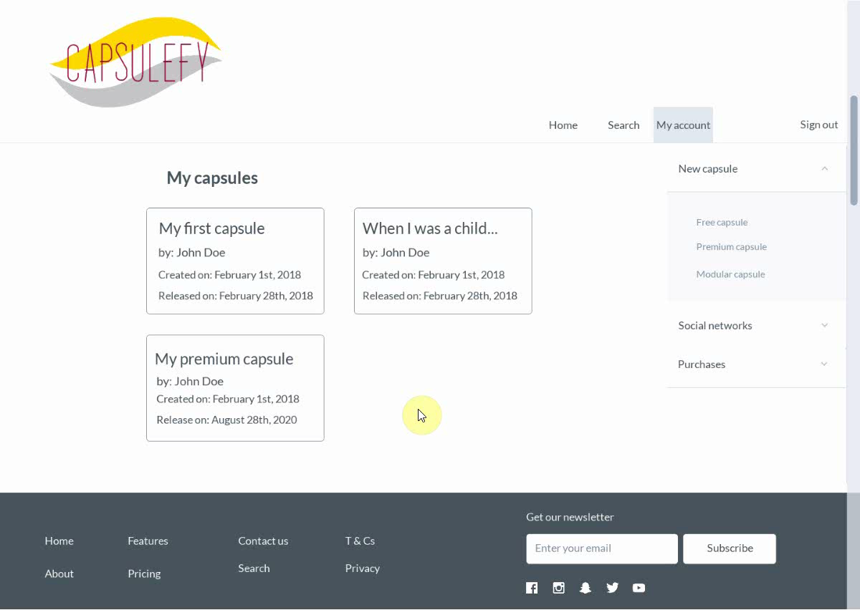
Logged-in user
Refresh capsules

Slide 20
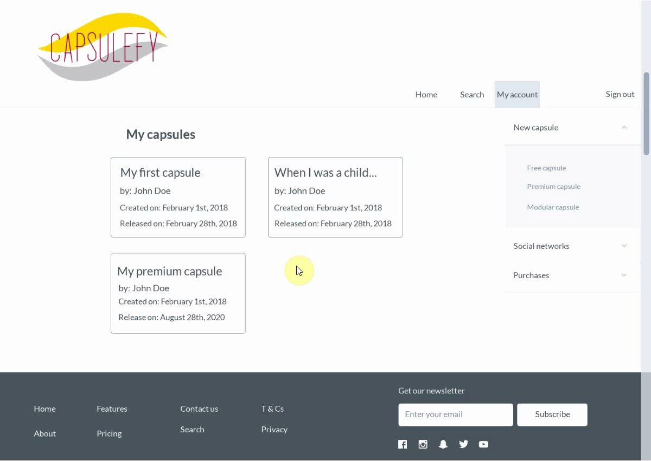
Logged-in user
Delete capsules

Slide 21
TECHNOLOGIES

Slide 22





TECHNOLOGIES
Main web app
Users and capsules APIs
Social media APIs

Slide 23





SUPPORTING TOOLS

Slide 24



ALM
Notes:
Mention Toggl, although it is not part of the ALM itself.

Slide 25

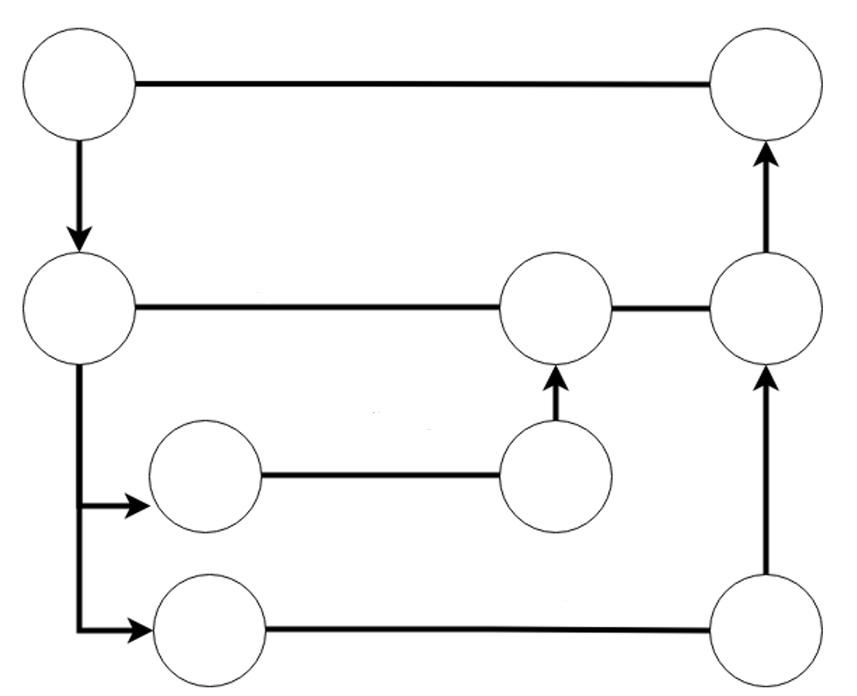
ALM
Master
Release X
Development
Features

Slide 26


HOSTING

Slide 27




TESTING
Functional
%
Integration
Performance
Coverage
Acceptance

Slide 28


TESTING
Functional & integration
Coverage
Performance

Slide 29
VIABILITY STUDY

Slide 30
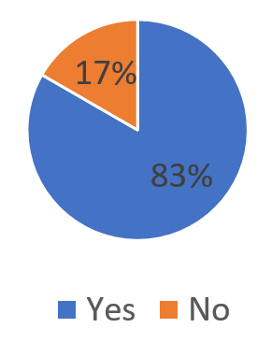
Do you know what a time capsule is?

Slide 31
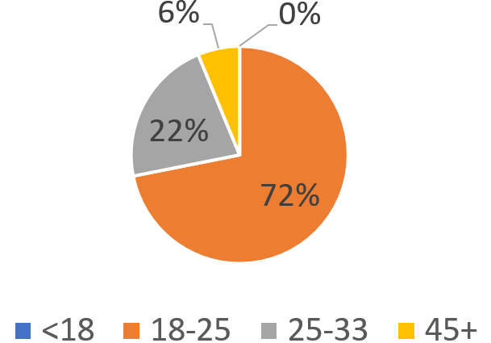
What is your age?

Slide 32
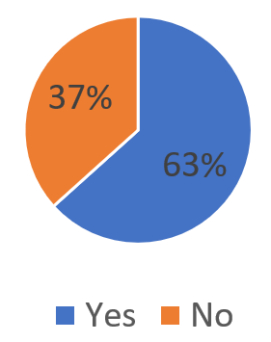
Are you interested in our idea?

Slide 33
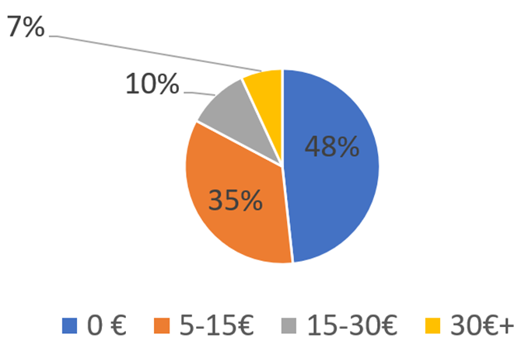
How much would you pay yearly?

Slide 34
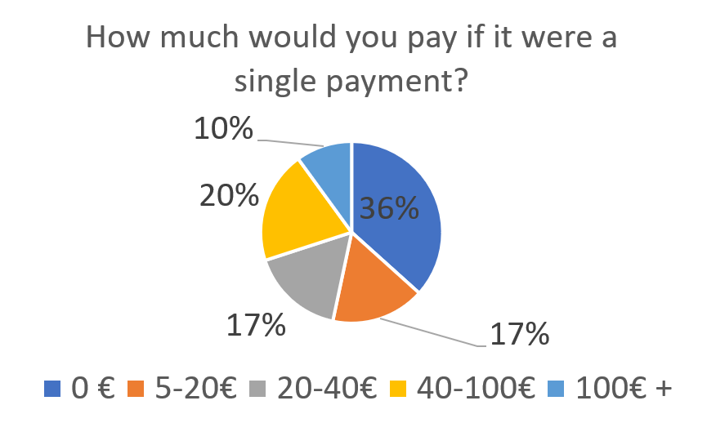
How much would you pay if it were a single payment?

Slide 35
COMPETITORS

Slide 36


COMPETITORS
 | Viajeros en el tiempo | Mytimecapsule | Miigen | thetimecapsule | Capsulefy
Automatic content publication
Free version
Premium version
Images
Videos
Social network interaction
Dead man switch

Slide 37



SWOT MATRIX
STRENGTHS | WEAKNESSES
OPPORTUNITIES | THREATS
Deadman switch
and customization
New to the
market
Insurance companies
Competitors and lack of trust

Slide 38
PILOT USERS

Slide 39
PILOT USERS
Name | Age
Francisco R. | 55
Javier A. | 19
Valentin A. | 19
Antonio G. | 26
Name | Age
José Manuel J. | 21
Sandra C. | 28
José Manuel D. | 21

Slide 40


COMMITMENT

Slide 41
PAYMENT PLANS
 | Free | Premium/Modular
Price | 0 € | 11.99 €
Storage | 20 MB/user | 500 MB/capsule
Social network and email integration
Capsule scheduling | Up to 1 year | No limit
Capsule expiration | 6 months after release | No expiration
Private capsules (user-targeted)

Slide 42
VIDEO CONVERSION RATES
Quality (p) | MB/minute
144 | 1.3
240 | 3.3
360 | 5
480 | 8.3
720 | 25
1080 | 50

Slide 43

PLANIFICATION
Each week
Sprint planning
Send deliverable
Each deliverable

Slide 44
PLANIFICATION
First sprint | Core use cases Piloting plan
Second sprint | Full MVP Feedback taken into account
Third sprint | Polished MVP

Slide 45
FIRST SPRINT: WEEK 1
Task | Assignees | Hours
Data model | Adrián, Daniel, Juan, Pablo | 8.5
List capsules | Juan | 1
Display capsule | Adrián | 2
Create/edit/delete basic capsule | Rafael | 2.5
User login | Juan | 1
Frontend | Daniel | 2

Slide 46
FIRST SPRINT: WEEK 2
Task | Assignees | Hours
Modular and private capsules | Adrián, Juan | 4
Search capsules | Daniel | 2
Deadman switch | Pablo | 3
Email automation | Juan | 2
Social network integration | Rafael | 3
Frontend | Daniel | 2
Piloting plan | Adrián | 2

Slide 47
COSTS

Slide 48


COSTS
Realistic: 25218.33 – 26518.68 €
Optimistic: 24363.82 €
Pesimistic: 28501.39 €
Project duration: 4 months
Notes:
Factors taken into account: salaries, workplace, hosting, adversitement.

Slide 49
COSTS (REALISTIC 1)
Project duration | 4 months
Salaries | 20.80 €/hour
Hours per month | 40
Amortization (months) | 60
Equipment | 306.67 €
Hosting (1 year) | 669.34 €
Advertising (6 months) | 300 €
Risk prevention | 3% (734.51 €)
Total | 25218.33 €

Slide 50
COSTS (REALISTIC 2)
Project duration | 4 months
Salaries | 20.80 €/hour
Hours per month | 40
Amortization (months) | 60
Equipment | 306.67 €
Hosting (1 year) | 669.34 €
Advertising (6 months) | 600 €
Risk prevention | 7% (1734.87 €)
Total | 26518.68 €

Slide 51
COSTS (OPTIMISTIC)
Project duration | 4 months
Salaries | 20.80 €/hour
Hours per month | 40
Amortization (months) | 60
Equipment | 306.67 €
Hosting (1 year) | 669.34 €
Advertising (6 months) | 180 €
Risk prevention | 0% (0 €)
Total | 24363.82 €

Slide 52
COSTS (PESIMISTIC)
Project duration | 4 months
Salaries | 20.80 €/hour
Hours per month | 40
Amortization (months) | 60
Equipment | 306.67 €
Hosting (1 year) | 669.34 €
Advertising (6 months) | 600 €
Risk prevention | 15% (3717.57 €)
Total | 28501.39 €

Slide 53




RISKS
Notes:
Computers not working, contracts changing, servers down, incompatible schedules, negative reception and losses.

Slide 54
PROFIT ESTIMATION

Slide 55
PROFIT ESTIMATION
Year 1: 2000 sales
Balance: -4563 €
Year 2: 4000 sales
Balance: 21878 €
39600 €
24363 €
19800 €
13159 €
Losses
Earnings
Losses
Earnings

Slide 56
PROFIT ESTIMATION
Year 3: 8000 sales
Balance: 87055 €
79200 €
14023 €
Losses
Earnings

Slide 57
THANKS!
Notes:
Insurance companies: offer capsules to their clients, with no expiration and special prices. Create endpoint for insurances to send their client data.

Slide 58

https://capsulefy.herokuapp.com
capsulefy.communications@gmail.com
https://marvelapp.com/4395g15/screen/53795517

Slide 59

CORE USE CASES
Refresh deadman switch
Select type of capsule
<<includes>>
Unregistered user
Registered user
Pay for a
capsule

Slide 60
CORE USE CASES
Delete
capsule
Create free
capsule
Unregistered user
View
capsule
Registered user

Slide 61
FIRST SPRINT
- Prepare development environment
- Implement data models
- Work on requirements
- Test the system
- Take actions according to feedback

